Slide 1
Project Title: COVID-19 Awareness Platform Team name: Blitzkrieg Team leader name: Vikram.B.M
Domain: Environment
Problem Statement: You are being a chief secretary to health, higher education and research ministry create a platform for various strategies or methods to overcome situations like new virus spreads and its prevention.

Slide 2
Idea / Approach
Website to spread awareness about COVID-19 by answering FAQs about Coronavirus , giving Latest Updates , showing the current cases/Stats in India , community forum for users to discuss and answer each others queries about coronavirus.
The website also provides travel advice , media resources, research and development , Strategic preparedness and response plan, COVID-19 Supply Chain System, Mythbusters during the Corona Virus / COVID-19 crisis.

Slide 3
Technology Stack and Use Cases
We have used HTML, CSS, Javascript, Python, Beautiful Soup and Web browser / websites to build our Platform for COVID-19 Total awareness to our users.
Used to spread awareness about COVID-19 by providing facts, mythbusters, current/live COVID-19 cases/stats in India , Latest Updates, travel advice, media resources, research and development , Strategic preparedness and response plan, COVID-19 Supply Chain System, showing the current cases/Stats in India , community forum for our users to get complete awareness of the coronavirus crisis during this quarantine.

Slide 4
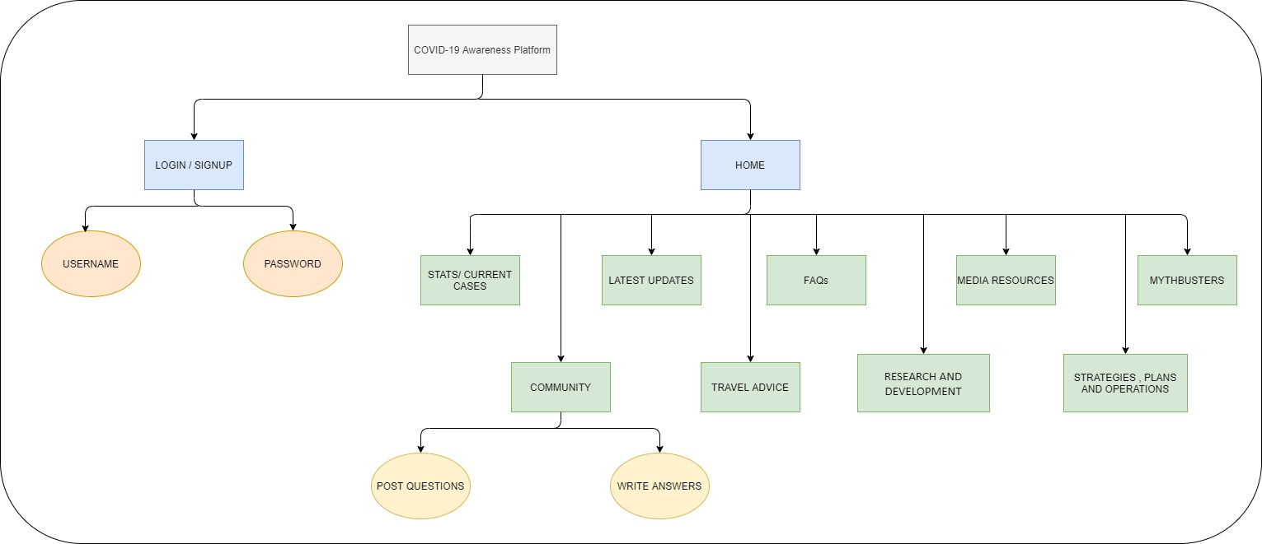
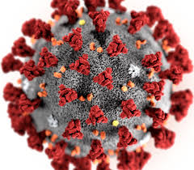
Block Diagram / Architectural Diagram

Slide 5
Dependencies
Software dependencies :
Web Browser
Internet connection

Slide 6
Social Impact Analysis with COVID19
We are spreading awareness about COVID-19 by providing them with facts , FAQs , prevention measures, threat level ,cases/statistics during coronavirus crisis in quarantine.
Thus, the users of our website will be much more cautious , careful and will maintain social distancing , wear masks while going outside and will Stay at Home after understanding the dangerousness of COVID-19 and will follow preventive measures.
Thereby, decreasing the spread of COVID-19 and eventually decreasing the number of cases of this pandemic disease in this country.

Slide 7
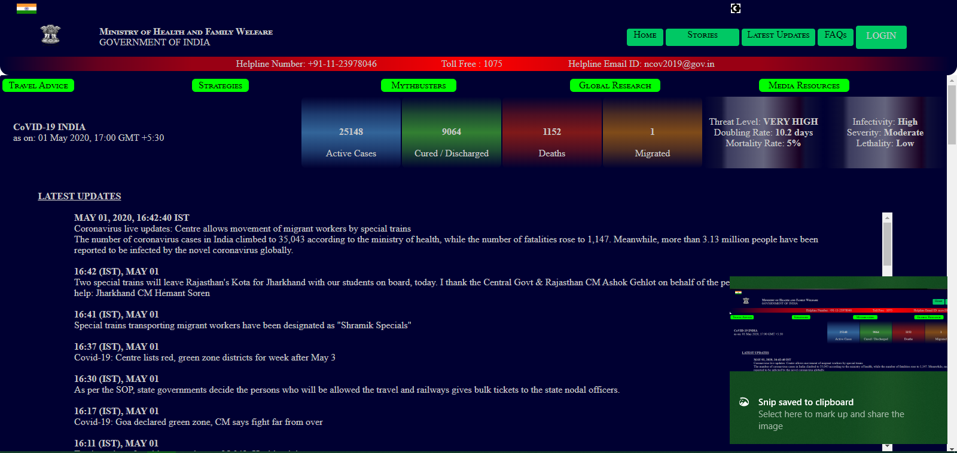
Implementation

Slide 8
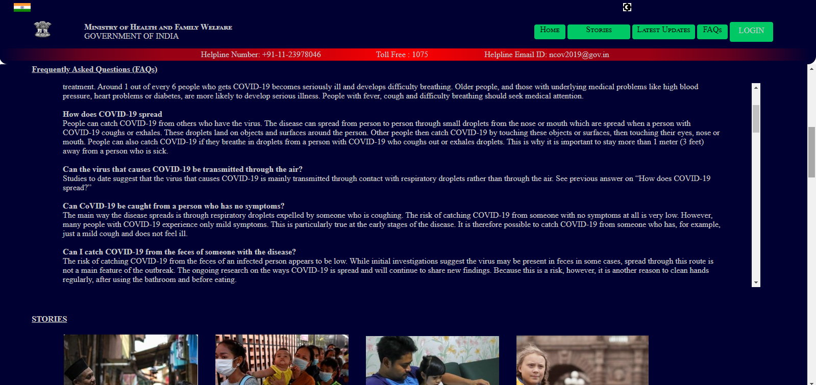

Slide 9
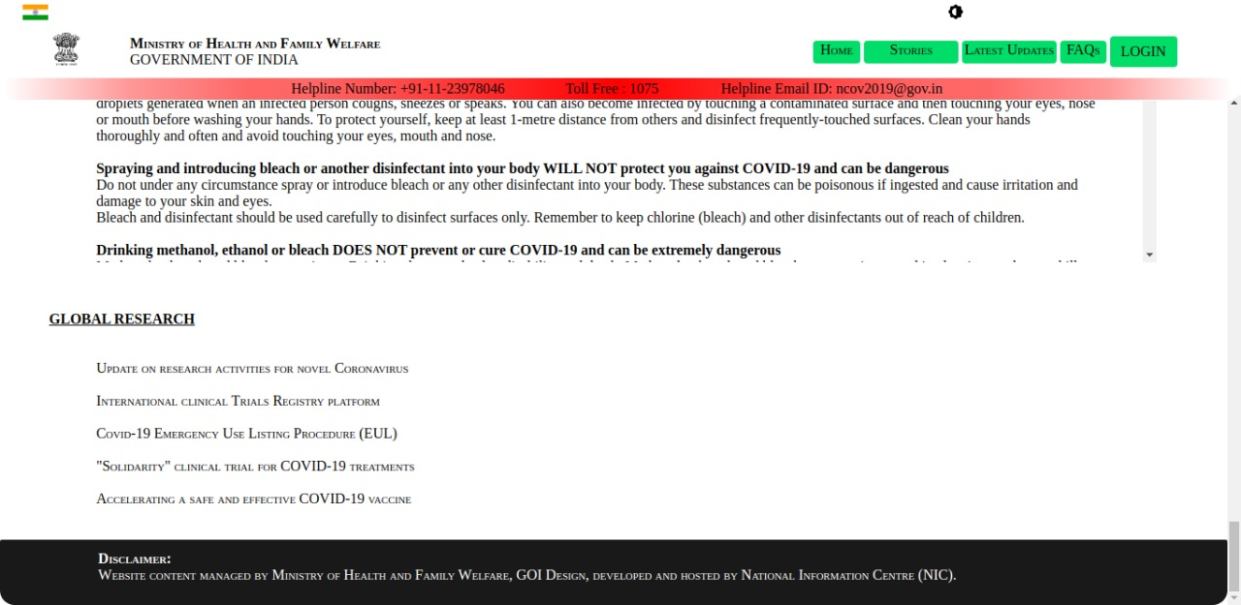

Slide 10
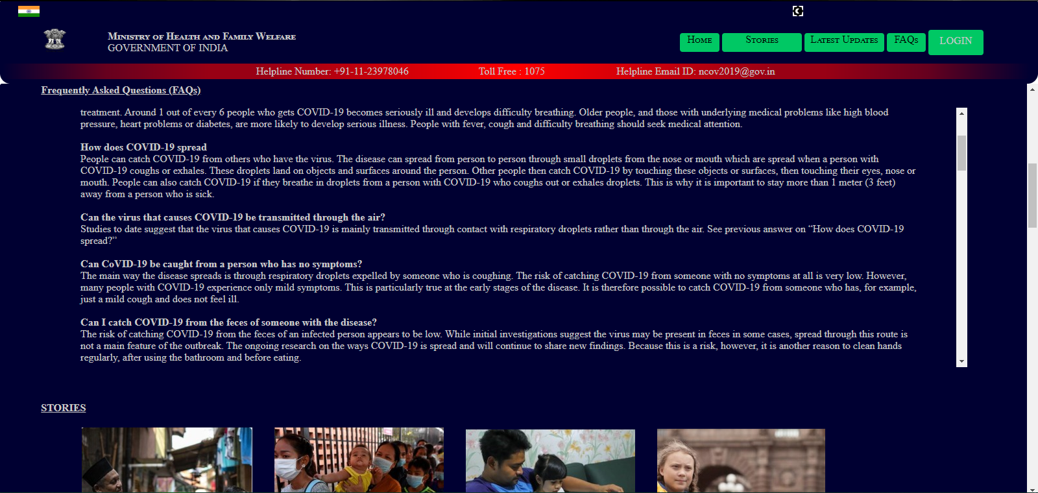

Slide 11
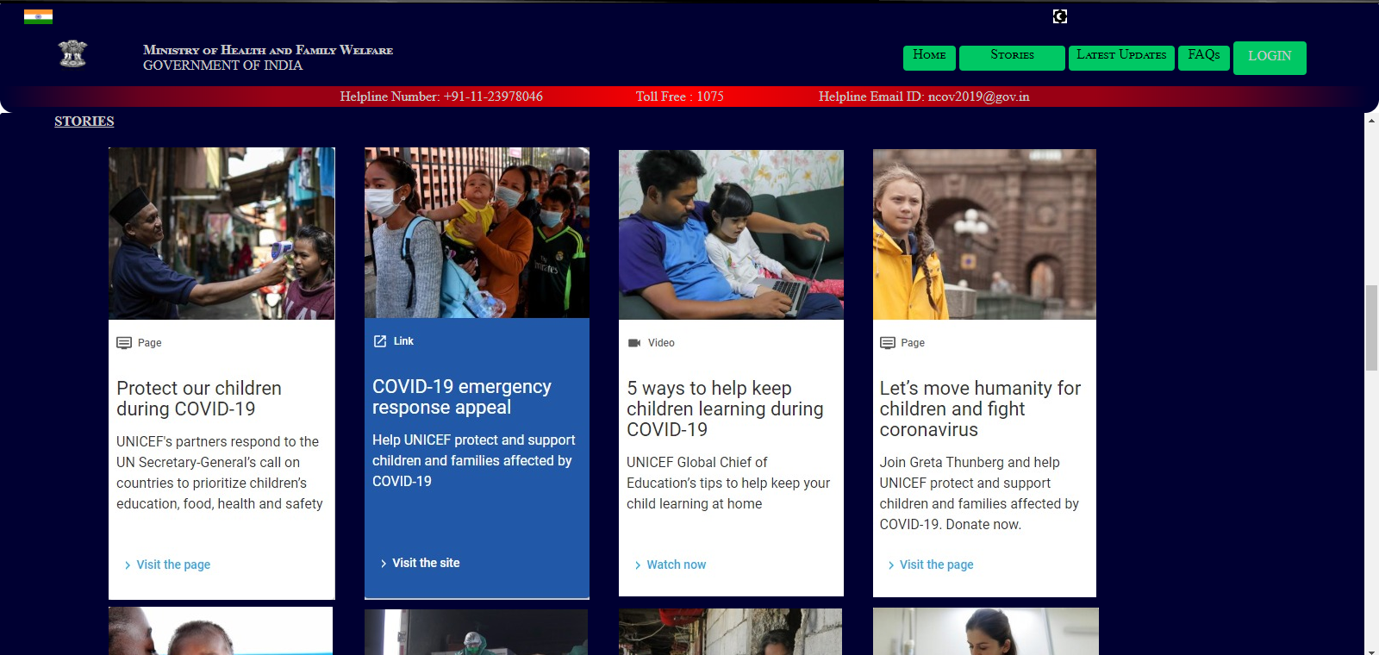

Slide 12
Link to the project
GitHub link:
https://github.com/Vikram-BM/COVID-19-Awareness-Platform
Google Drive link:
https://drive.google.com/file/d/1MoiVFqXaUtSYw4h0FkriwyGpz9xsfnSk/view?usp=sharing

